Slide 1
Crash Survival Prediction and Analysis of Seattle Collision Data
UC Davis Data Analytics
Justin Dean, Madeline Gutieruiz, Belay Kondidie, and Riley Unverferth
Notes:
Riley

Slide 2
Introduction
In transportation safety, predicting the likelihood of survival from vehicle crashes has emerged as a crucial area of research and development. With increasing number of Vehicles on the road, understanding contributing factors to collisions and chance of survival, is crucial to policy makers and the public that share the road.
By leveraging advancements in data analytics and machine learning, our team has developed predictive model capable of estimating the probability of survival in various crash scenarios and have analyzed Seattle’s vehicle collision data between 2004-2021.
Notes:
Maddy

Slide 3
Project Goals
To developing an app that will predict the degree of injury based on the conditions of crashes in Seattle, Washington.
Analyze Seattle traffic collision data to identify major contributing factors to injuries and fatalities, and share findings with stakeholders
Notes:
Maddy

Slide 4
How it works…
Tableau Public
Map
HTML
Seattle SDOT Collision Data
StreamLit
Tableau Public
Graphs
Machine Learning
Notes:
Justin

Slide 5
Methodologies and Steps Used
Methodologies and Steps Used
Machine Learning
Publicly available data was accessed from Seattle SDOT Collisions Data.
Data was cleaned, analyzed, and visualized using Pandas Python.
The prediction model is powered by an XGBoost multiclass classification machine learning model.
This model has 4 outcome variables.
Tableau Visualization
Developing the app
Various charts and storyboard was created to see major contributing factors of collisions and injuries.
The results could be useful for policy makers and educating the public.
This app is powered through HTML and hosted on SteamLit for public accessibility.
Notes:
Justin

Slide 6
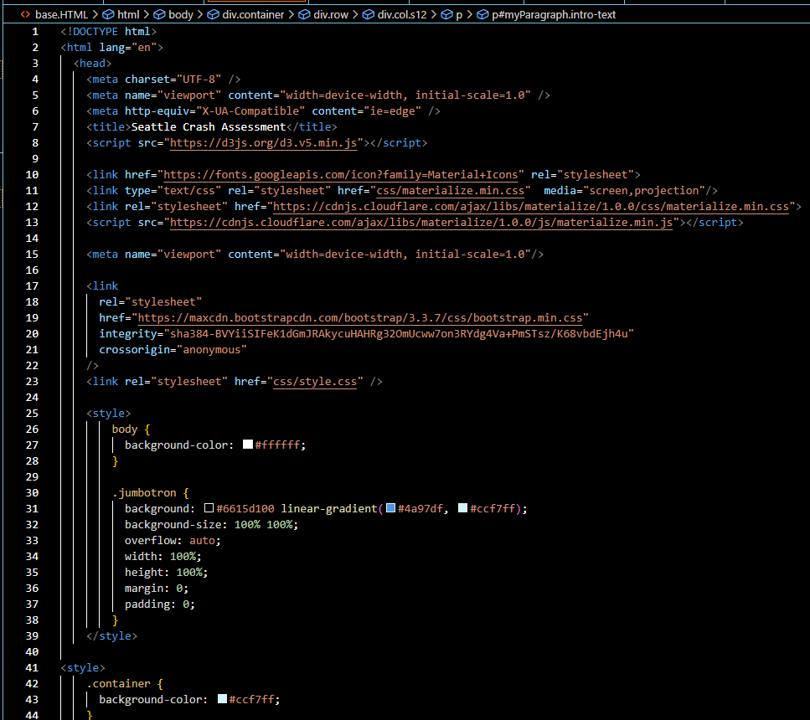
HTML
HTML files were created to host the web layouts for our app. We designed the web layout to allow our users to gain information about our project with an easy user interface.
Connected on CSS files to add design features to our app
Background colors, container designs, app text, etc.
Notes:
Maddy

Slide 7
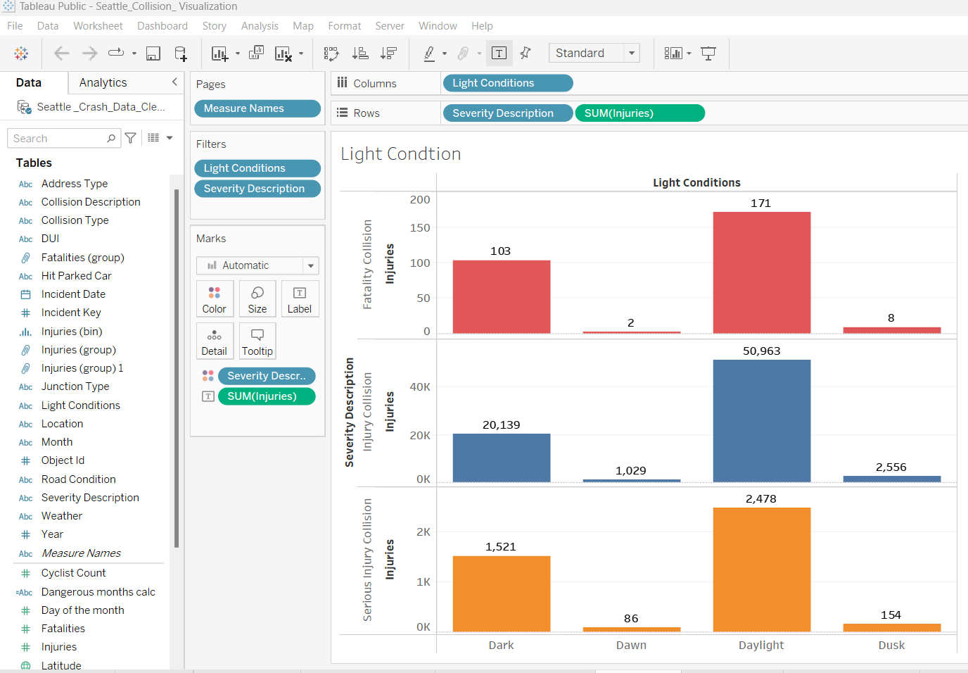
Tableau Public
Data from the Seattle SDOT Collision Dataset was used to create graphs to tell a story about crashes that occured in the city.
Interactive Maps were also created to give the users more visuals
Timeframe of this data 2004 - 2021
Notes:
Belay

Slide 8
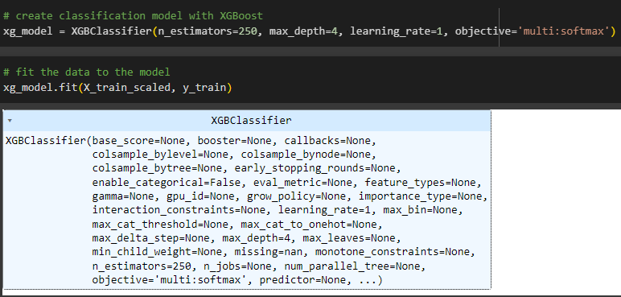

Machine Learning
Gradient Boosting
Multiclass Classification
Property Damage Only Collision
Injury Collision
Serious Injury Collision
Fatality Collision
Notes:
Riley

Slide 9
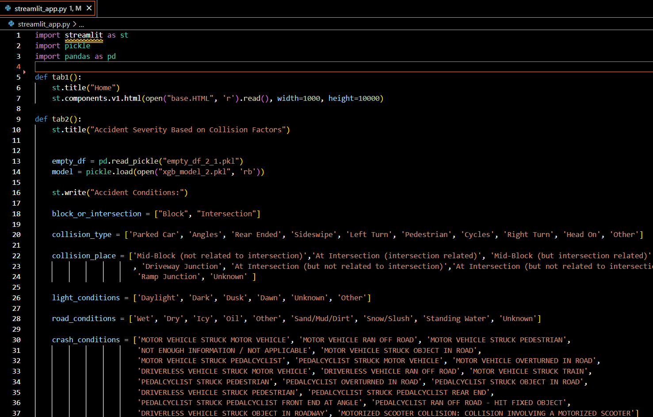
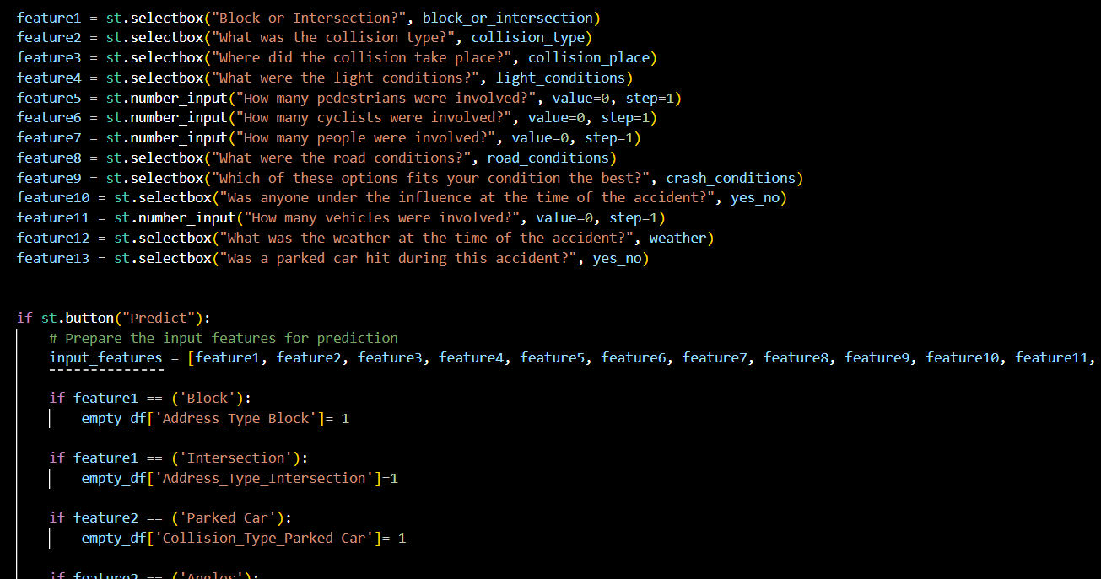
StreamLit
StreamLit was used to power our app as a whole. It connected the HTML files, Machine Learning Model, and Tableau Public files to produce an interactive web app.
Streamlit turns data scripts into shareable web apps in minutes.
Notes:
Justin

Slide 10
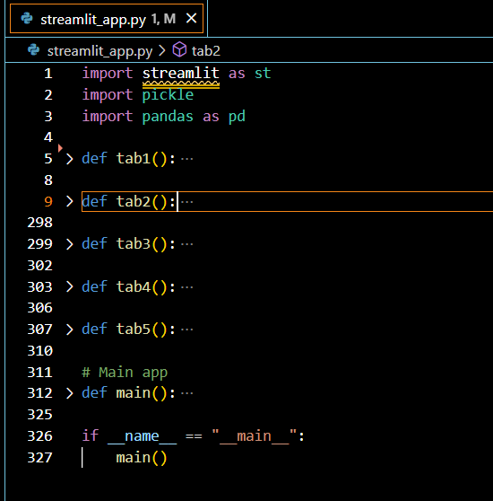
Let's dive into the app
Git Bash Command: streamlit run streamlit_app.py
URL = https://seattle-crash-model.streamlit.app/
Notes:
Justin Show the app,

Slide 11
Project Challenges
Choosing the best model to get the most accurate ratings.
Original data set was too large for SQLite
Random forest
Decision tree
XGBoost multiclass classification
Version issues
Downgraded pandas
Pickle protocol 4 (from 5)
Connecting the prediction model to StreamLit to create a publicly accessible model.
Notes:
Maddy will start then justin can talk about streamlit

Slide 12
Summary and conclusions
App Summary:
Our app is interactive for our users
Hosted on StreamLit, generated on HTML
Graphs and Map is powered by Tableau Public
Our prediction tool is powered by XGBoost multiclass classification machine learning model.
Recommendations:
Since most fatalities occur at pedestrian crossing intersections and when driving under influence, law enforcement activities and public educations should focus in addressing those areas.
Easily visible signs and traffic police should be available at angles and intersection areas.
More officers and controllers should be on the road during dangerous months to keep the public safe.
Notes:
Belay

Slide 13
Thank you
The Dream Team
Notes:
Riley

